Slide 1
CRASH DETECTIVES

Slide 2
INTRODUCTION
With the City growing, more cars on our streets, and traffic congestion has become a challenge.
The World Health Organization (WHO statistics show that approximately 1.35 million people in the world.
Each year in Canada, about 2,000 people are killed and 165,000 are injured, (10,000 seriously) while using our road transportation system and costs society $37 billion (2.2% of Canadian GDP) annually. (Transport Canada, 2015, Draft Report on the Social Costs of Collisions in Canada, 1996-2012)
In Toronto alone, 100s of people were killed each year while trying to move around throughout the city. Bikers, pedestrians, children, and older adults were particularly vulnerable on the city’s streets.
In 2021, Toronto recorded a total of 63 traffic deaths, up from 46 in 2020 and 64 in 2019. Each year, pedestrians are the most vulnerable on the roads. Toronto lost 29 people who were walking in 2021, 23 in 2020 and 39 in 2019.

Slide 3
IMPORTANCE OF ANALYZING TRAFFIC ACCIDENTS
Accurately analyzing accidents can help governments to better the safety of their roads and highways.
Identifying high areas of accidents and high areas of accident severity can highlight areas of concern.
It can also be beneficial to insurance companies looking to change their rates in different areas.

Slide 4
OUR AGENDA/GOAL
The goal of this project is to investigate and determine what causes accidents and what attributes to their level of severity.
Through visualizations and machine learning algorithms, areas of concern will be highlighted, and the seriousness of accidents will be predicted as accurately as possible.

Slide 5
DATA INTRODUCTION
City of Toronto's Open Data Portal- https://open.toronto.ca/dataset/
Seriously injured/killed collisions data : https://open.toronto.ca/dataset/motor-vehicle-collisions-involving-killed-or-seriously-injured-persons/
Red light cameras data : https://open.toronto.ca/dataset/red-light-cameras/
Traffic collision data : https://open.toronto.ca/dataset/motor-vehicle-collisions-involving-killed-or-seriously-injured-persons/

Slide 6


What’s in the data?
Accident Number
Road Class
Collector
Time stamp
Accident Location
Intersection
Location
Visibility
Expressway and ramps
Lane
Local
Major + minor arterials with ramps
Latitude
Longitude
Driveway
Overpass or bridge
Underpass or tunnel
Trail
Private driveway…
Year
Date
Time
Clear
Fog, mist, smoke and dust
Freezing rain
Snow and Drifting snow
Strong wind…
Light
Daylight or dark
Dawn or dusk
Artificial lights…
Accident class
Vehicle type
Fatal
Non-fatal injury
Property damage
Manoeuvre
Automobile and station wagon
Motorcycle
Bicycle
Driver Action
Pick up truck
Street Car
School bus…
Turning left or right
Failed to yield right of way
Disobeyed traffic control
Lost control
Improper lane change
Speed too slow
Speed too fast for condition…
Stopped
Making U-turn
Overtaking
Changing lanes
Reversing …
Age of the involved
10 to 14
25 to 29
Over 95
15 to 19
20 to 24
……
Driver condition
Ability impaired, alcohol
Normal
Inattentive
Medical/physical disability
Fatigue
Ability impaired, drugs…

Slide 7

Technologies used
Data cleaning and exploratory analysis:
Pandas, numpy, seaborn
Database storage: PostgreSQL
Machine learning models: Decision tree,
Random forest,
Balance random forest and Gradient boosting
Dashboard:
Tableau public

Slide 8
RESEARCH QUESTIONS
Who does this project benefit?
When do/did the most accidents happen?
How do the available factors contribute to accident seriousness?
Can we create a machine learning algorithm that correctly predicts the severity of accidents?
Can we forecast the number of accidents in upcoming years based on the information available?
What are the limitations of the current data?
What things would help this research to be more accurate?

Slide 9
Who does this project benefit?
City Planners
Insurance Companies
Educating Pulic

Slide 10
EXPLORATORY DATA ANALYSIS
More Fatal accidents in areas without Red Light
More accidents happen in the beginning of Summer and Winter
Weekends are more dangerous. Fridays are worse.

Slide 11
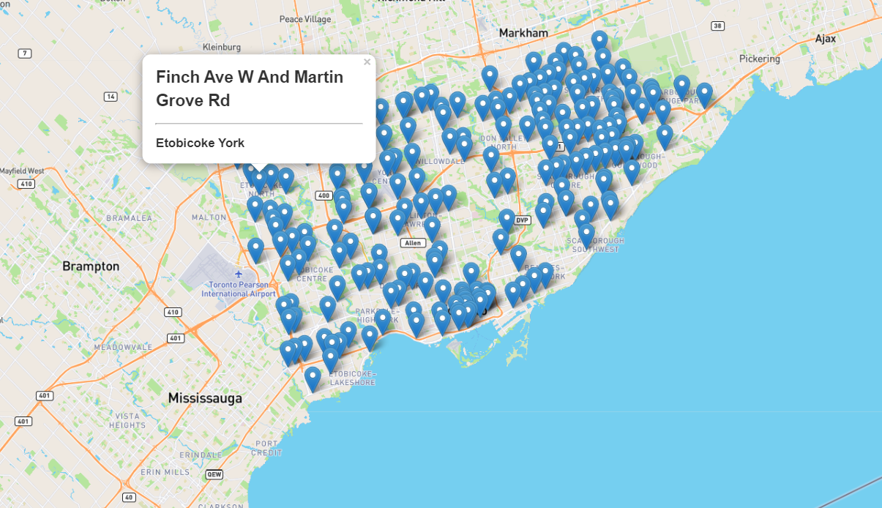
RED LIGHT CAMERA COORDINATES

Slide 12
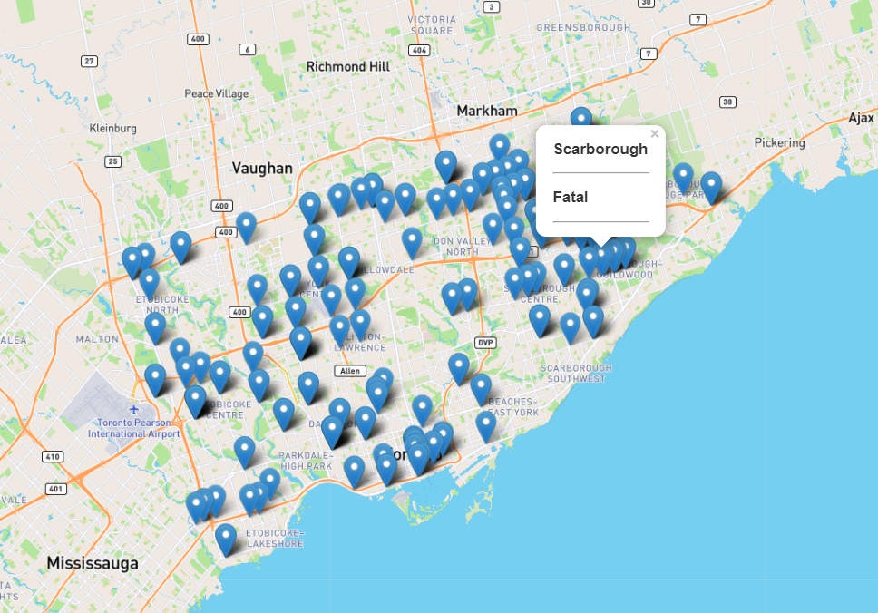
Accidents in Red Light Camera

Slide 13
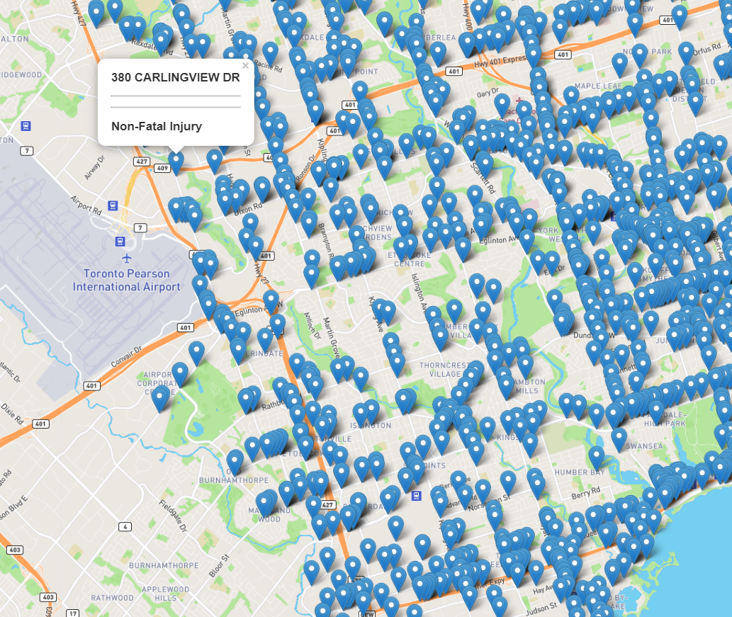
Accidents Without Red Light Cameras

Slide 14
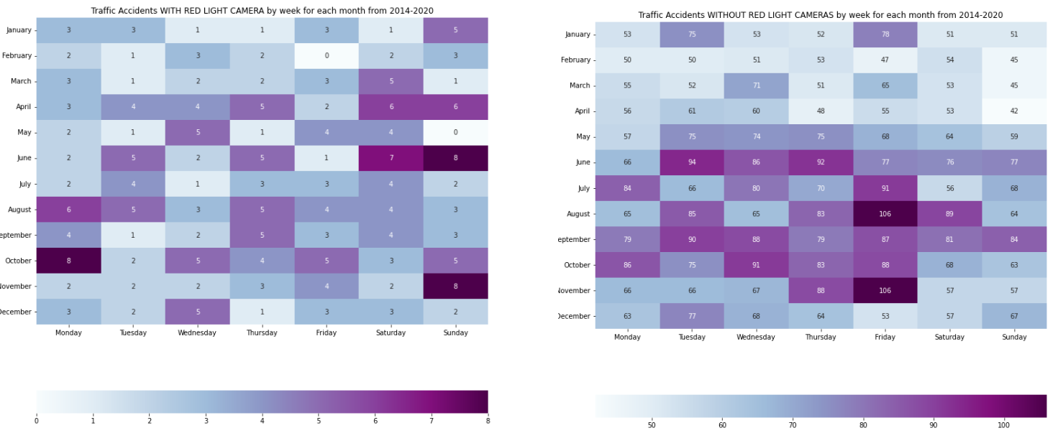
Heat Map for WITH and WITHOUT Red Light Cameras

Slide 15
POSSIBLE SOLUTION
From the data above more controlled areas would be beneficial. Maybe signs alerting drivers of the upcoming junctions, traffic lights, or stop signs would help in some of these areas where they are feasible.
ADD MORE…..

Slide 16
DASHBOARD
https://public.tableau.com/app/profile/kritika1614/viz/Roadaccidents_Toronto_viz/Dashboard2

Slide 17
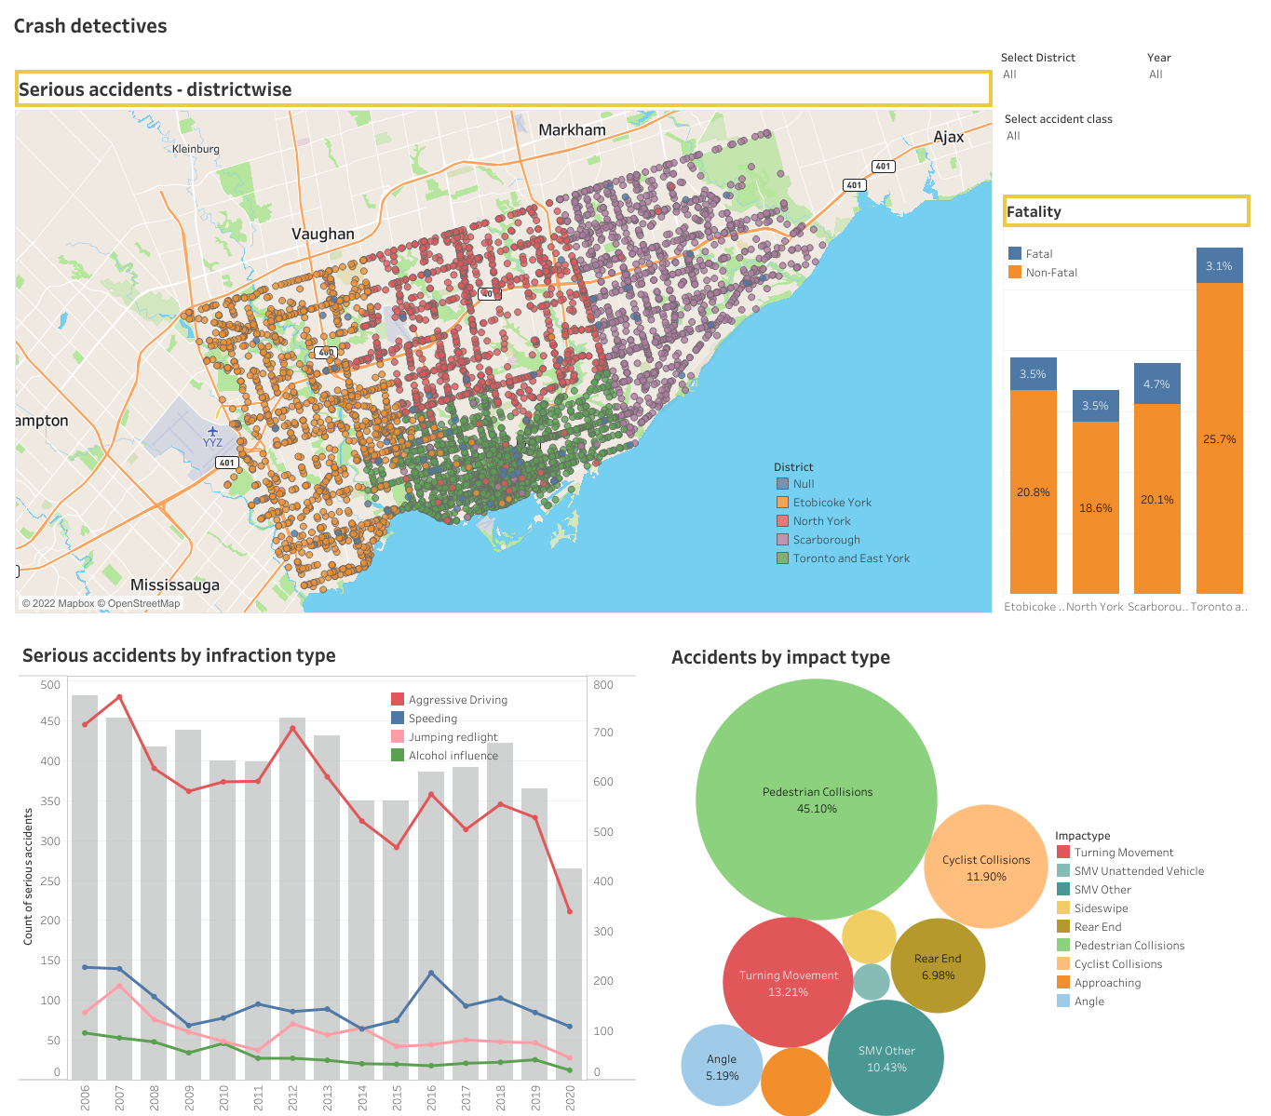
DASHBOARD

Slide 18
Machine Learning
In our machine leaning approach, we will be using
Classification models
Random Forest and Gradient Boosting.

Slide 19

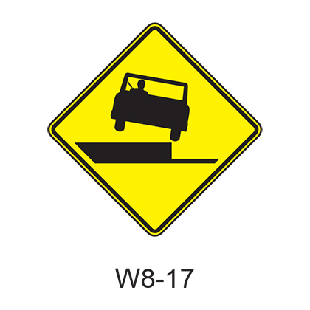
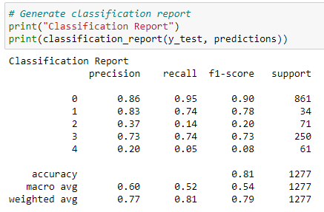
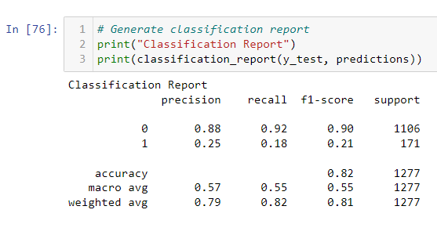
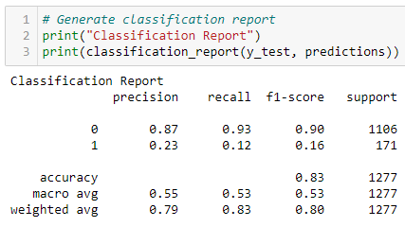
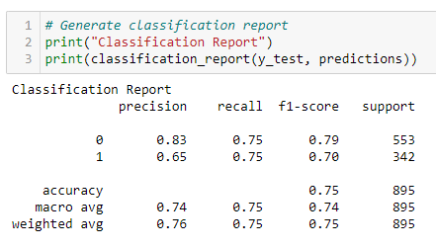
Machine Learning Steps Taken
Step
Step
Step
Step
Step
Run models with all data with injury type target
Target Accident Class
Refine Change encoding
Refine Remove Features
Success Use Over & Under-sampling
Results indicate over fitting and unclear results. Need to rethink the target. Pivot to use Accident Class.
Continued with label encoding. High F1, precision & recall on Non-Fatal predictions. Poor Fatal predictions.
Dig-in and make changes to remove any bias in the category encoding switch to one hot encoding from Label encoding
Remove features related to driver and focus on overall accident features
Correct class imbalance by over sampling fatalities and under sampling non-fatal accidents
Notes:
https://www.entrepreneur.com/article/253169

Slide 20
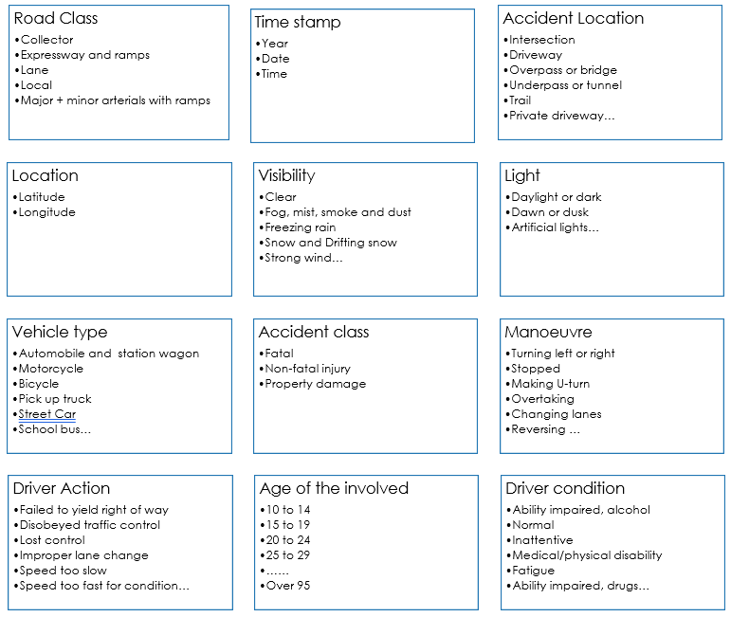
Machine Learning Steps Taken
The first stage involved keeping the majority of features with a few exceptions where the data could not be defined.
The data definitions for each raw file are found in the dataset folder
The models were pre-selected and include:
Random Forest
Gradient Boosted Tree
A size for the split into training and testing sets was not specified and therefore defaults to 25% with scikit-learn. Using Train_size or test_size the split can be specified.
The net result of this first run produced the following result
Step
Notes:
https://www.entrepreneur.com/article/253169

Slide 21
Machine Learning Steps Taken
This initial ML model run in step 1 was muddled. The some of the features were specific to the person involved in the accident and some of the features applied to the overall accident.
A decision was made to only run the model based on the overall accident and not individual participant and actions.
It also meant that the target changed from Injury type (specific to the person) to Accident Class (specific to the accident)
Classification report shows High F1, precision & recall on Non-Fatal predictions however the model performs poorly on Fatal predictions.
Step
Notes:
https://www.entrepreneur.com/article/253169

Slide 22
Machine Learning Steps Taken
+
Step
Step
Refinement
These steps involved making additional decisions:
Paring down the features to remove person specific data
Changes to the encoding from Label Encoder to One Hot Encoder because some categorical columns had a high number of categories. This change ensures there is no ranking of the values because everything is a 1 or a 0 instead of a numerical range
Classification report shows no real improvement over step 2. There is still a high F1, precision & recall score on Non-Fatal predictions however the model performs poorly on Fatal predictions.
Notes:
https://www.entrepreneur.com/article/253169

Slide 23

Machine Learning Steps Taken
Class imbalance was having a big impact on the ML model performance where it was being skewed by the high number of non-fatal records
To correct for this over sampling and under sampling was employed through trial and error and included:
Randomly extracting 50 records of each target and running the ML
Under-sampling the non-fatal records
Over-sampling the fatal accidents
The best result was doubling the fatal records and cutting in half the non-fatal records.
Success at last…
The F1 scores on both fatal and non-fatal predictions is high
Precision and recall are equally good
Step
Notes:
https://www.entrepreneur.com/article/253169

Slide 24
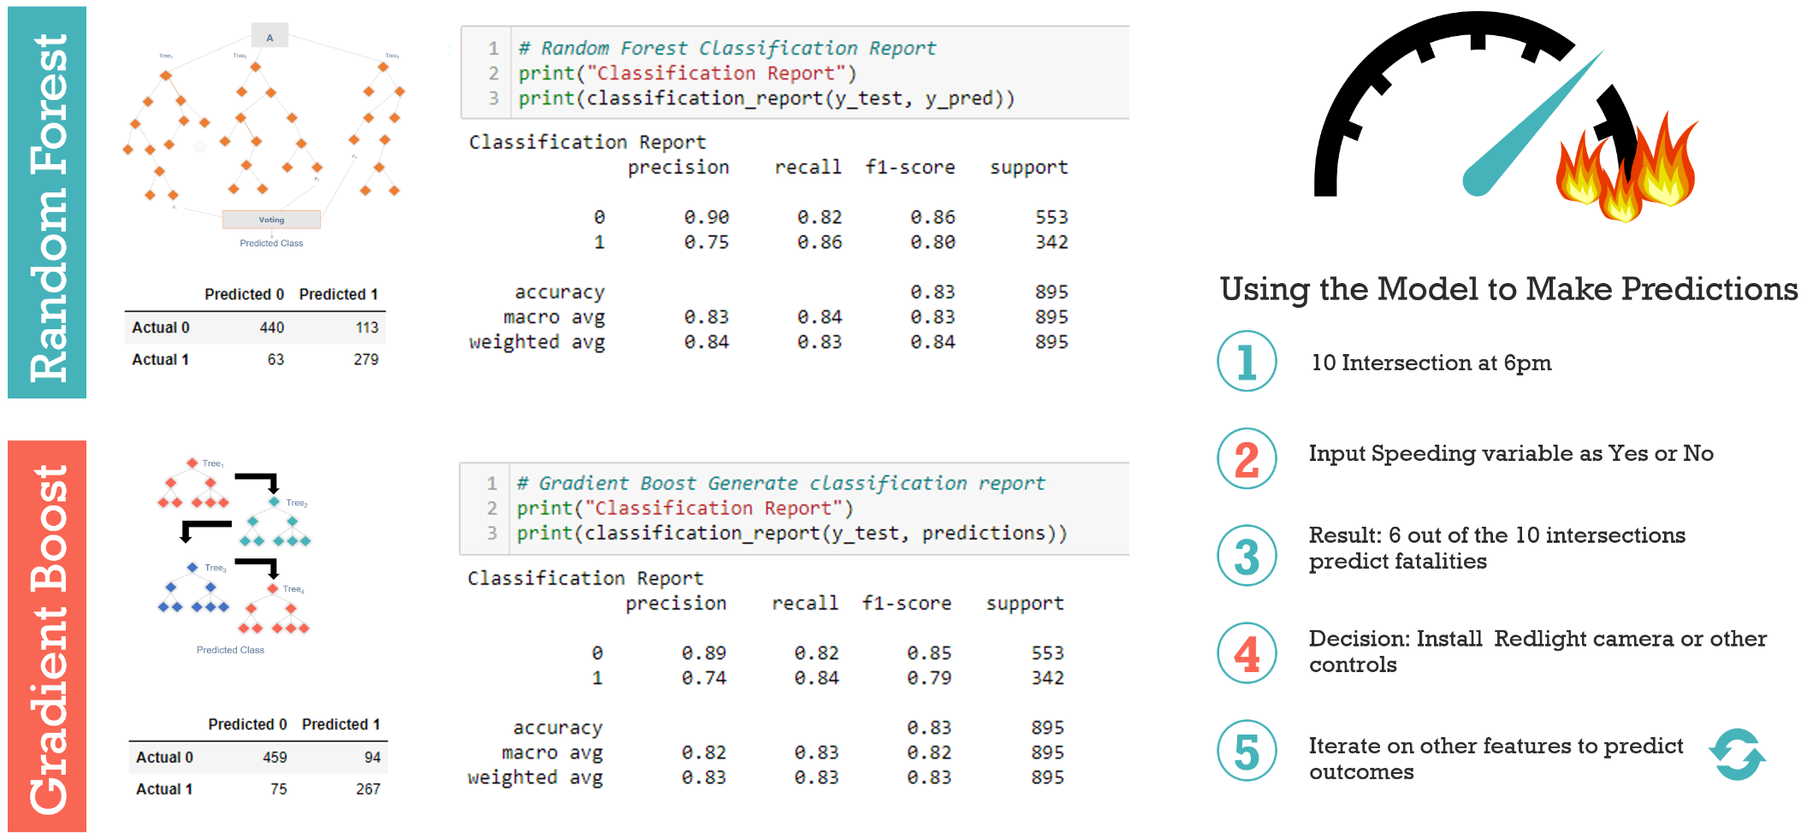

Slide 25
Expectations vs Reality
Expectation | Reality
Overall I thought there would be certain features that had a high impact on the severity of accidents. - Mention the features that has high impact - -- -- - - | There were very low/high correlations among features and accident severity. The highest correlation was WRITE FEATURE AND BY HOW MUCH

Slide 26
LIMITATIONS
Not able to obtain accuracy over 70% without causing other issues such as overfitting and bias.
The data was extremely imbalanced. The majority of accidents were not serious and while this is not a real life problem, it was a problem for this model. Undersampling was done to improve overall scoring.
More factors surrounding accidents should be included in this data.
Speed limits were missing
No information on cellphone usage of drivers
Correlations?????

Slide 27


The Team
ADITI
BARDHONIA
KRITIKA
RICHELLE

